Slide 1

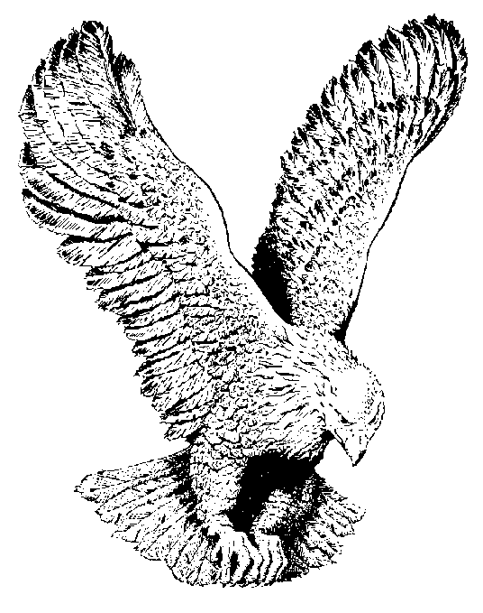
218
HOW GREAT THOU ART!
When I consider the works of my God,
The moon and the stars, the path that He trod.
The sheep and the oxen, the beast of the field,
All of these wonders make me know that He’s real.

Slide 2
CHORUS
How great is our God! How great is His Word!
He’s the greatest one that ever was heard.
He rolled back the waters of the mighty Red Sea,
And He said, “I will lead you,
Put your trust in me.”

Slide 3
He used our prophet in many a way
To show forth His greatness in this our day.
He never changes; He’s always the same,
So worship and praise Him and love His dear Name

